Slide 1
Automated Bone Age Assessment.
19MCA027 – Parth A. Patel
19MCA031 – Taki Rushnaiwala
Created By: Simpler_20

Slide 2
Introduction
Bone age assessment is essential topic in the clinical practice for evaluating the maturity of the children.
The surgeons can estimate a child’s growth by determining their ‘Bone Age’.
They do this by taking an X-Ray of the hand wrist to see which growth plates are still open.
The bone age may be different from the child’s actual age.
Like Example: The age of the boy is 3 years indicates their average adults height bone range between 165 to 180 cm.

Slide 3
Social Impact
Manual method is time-consuming and prone to observer variability (it means failure by the observer in a test to measure accurately).
That’s why it is attractive to developed computer-aided and automated methods for ‘Bone Age Assessment’. In this we present a fully ‘Automated Bone Age Assessment’ system.
So, using this system the surgeons can easily and immediately identified the maturity of the children.

Slide 4
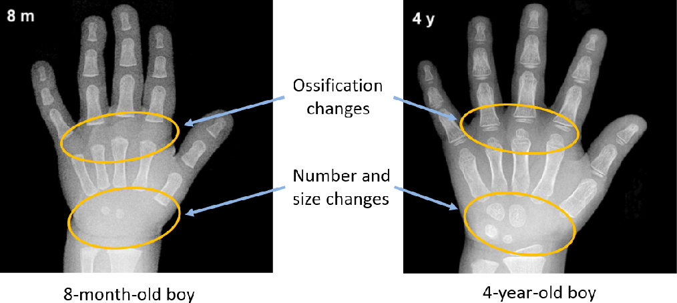
Differentiate between Hands with different aged boy.
References: https://www.semanticscholar.org/paper/Using-Convolutional-Neural-Networks-and-Transfer-Zhou-Li/ce5ac584230d3f2b6a9642b23cca277db0271b72/figure/0

Slide 5
Automated Bone Age Assessment.
Deep Learning is a part of machine learning which makes the computation of multi- layer neural network.
Convolutional Neural Network is a class of Deep Neural Networks.
In this Automated bone age assessment project we use Transfer Learning to reach minimum loss and get better accuracy.
Xception - its a Depthwise Seperable Convolution, better than Inception-V3(Google).
We use pre-trained Xception model with no Fully Connected Layer and with ‘ImageNet‘ features.
ImageNet, is a dataset of over 15 millions labeled high-resolution images with around 22,000 categories, and its Highest accuracy is between 0.79 to 0.94
References:1. https://towardsdatascience.com/review-xception-with-depthwise-separable-convolution-better-than-inception-v3-image-dc967dd42568
References:2. https://www.tensorflow.org References:3 https://arxiv.org/abs/1505.04597

Slide 6
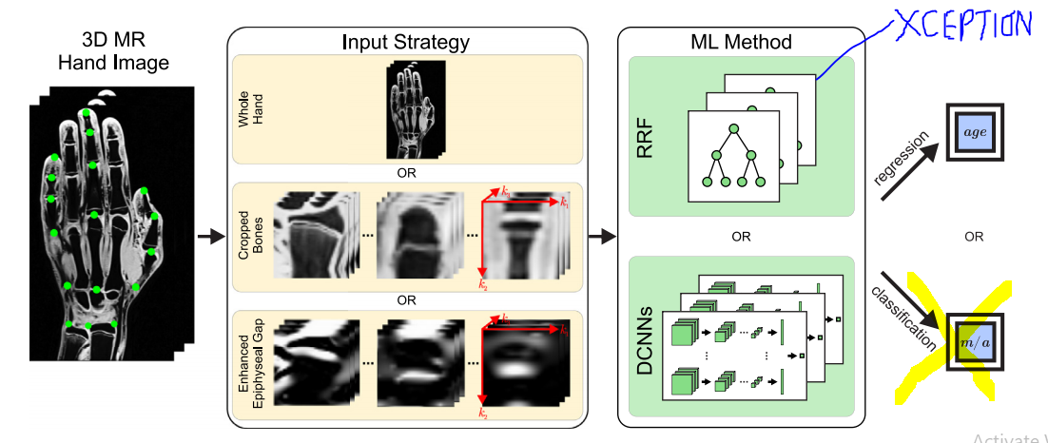
Convolutional Neural Network Image Classification
References:1.https://www.hindawi.com/journals/ijbi/2020/8460493/

Slide 7
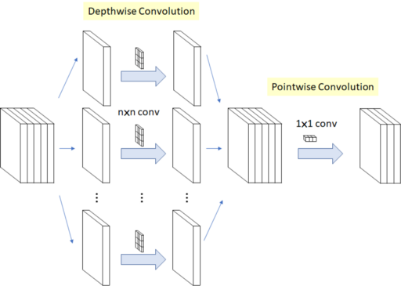
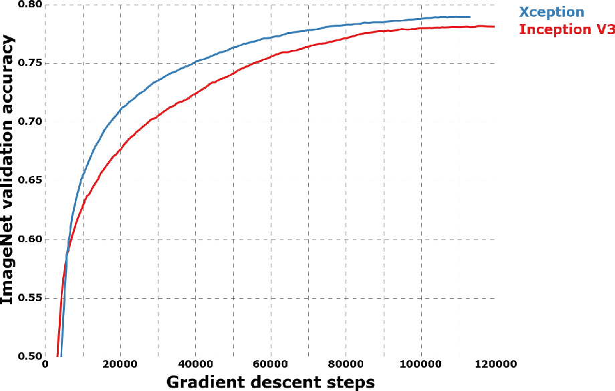
Xception
References:1.https://www.google.com/

Slide 8
Automated Bone Age Assessment.
This system is support supervised learning method, that’s why we use linear regression method to classifying the age over the mean height of the bones for the age of the children in the datasets.
We use ‘Mean Squared Error’ to reach minimum loss function.
After 20/50 Epoch our loss: 0.0145 and validation_loss: 0.0894.
This model train run time 7612 seconds (126 minutes) with GPU acceleration so, its not supported in our system, so we use pre-trained Weights for validate the model.

Slide 9
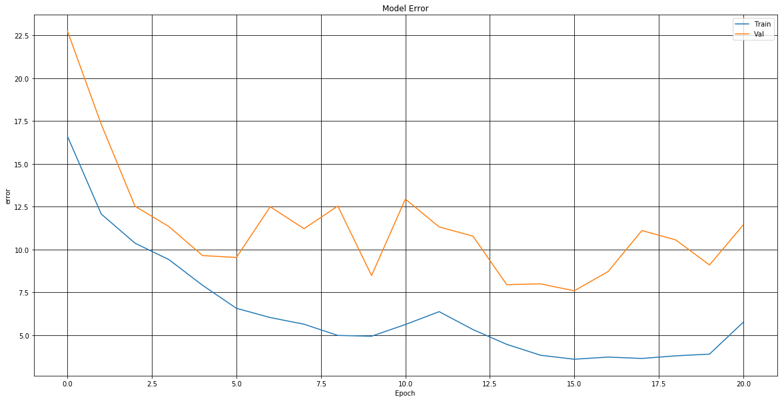
Train / Validation Error

Slide 10
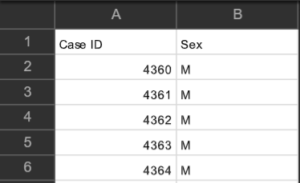
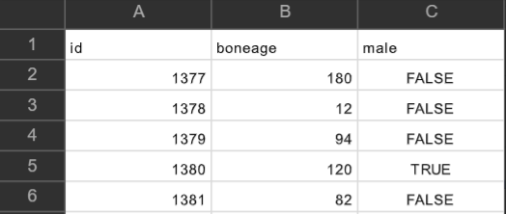
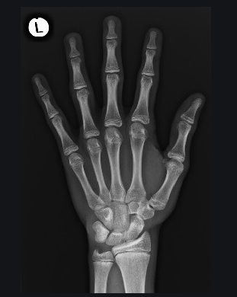
Datasets
Boneage-test-dataset.csv
Boneage-train-dataset.csv
Boneage-train/test-Images
Train Image Size: 12.6K
Test Image Size: 200
Train Images also Consist of 80% trainable images and 20% validation images.
References: https://www.kaggle.com/

Slide 11
Total 90% of Project Completed.
And 10% Consists of Testing and Deploying the Model.

Slide 12
Thank You
19MCA027 – Parth A. Patel
19MCA031 – Taki Rushnaiwala
Created By: Simpler_20

